Slide 1
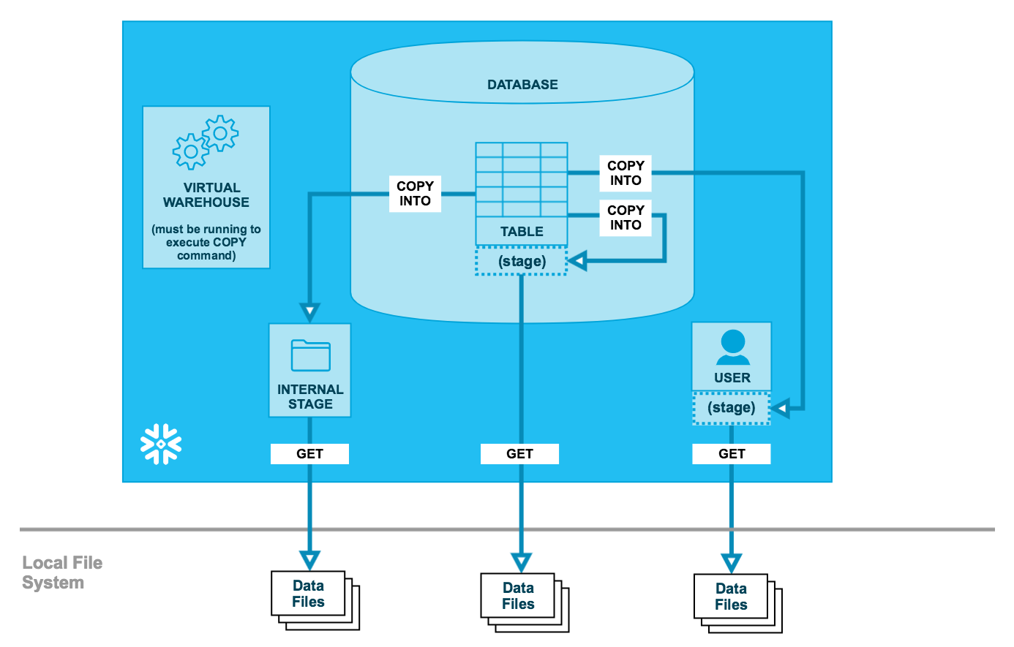
Data Unloading / Export

Slide 2
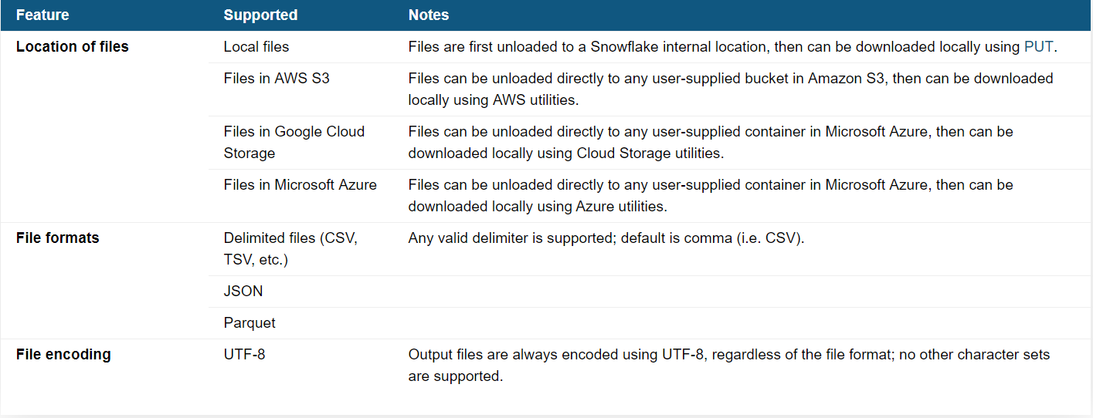
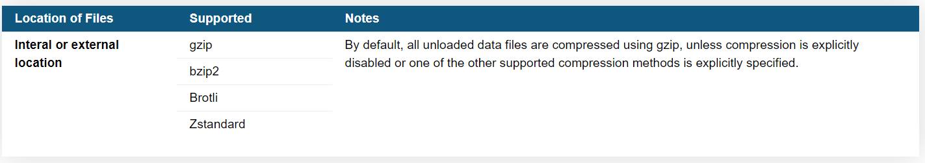
Unloading – Output File Details

Slide 3
Data Unloading / Export
Bulk Unloading
Bulk Unloading
SQL Query Based Unloading
Bulk Unloading to Multiple Files
Unloading onto AWS S3 / GCP / Azure
Default Unloaded File Size – 16 MB
Max File Size on Cloud Storage– 5gb for AWS / GCP 268 MB for Azure
Using the Copy Command export the data into any of the stages
Using Get Command the data can be downloaded into local file system

Slide 4
Data Unloading / Export
Unloading Table into Different Stages
Table Stage --
copy into @%my_customer/result/data_ from my_customer file_format = (format_name =‘my_csv_format' compression='GZIP');
Named Stage –
copy into @my_temp_stage/result/data_ from (select * from my_customer) file_format=(format_name=‘my_csv_format' compression='gzip');
User Stage – By Query
copy into @~ from _my_customer file_format=(type=csv null_if = ('NULL', 'null') empty_field_as_null=false);
copy into @~ from (Select * from MY_CUSTOMER limit 10) file_format = (format_name = 'my_csv_format') validation_mode='RETURN_ROWS’
Unloading By Query -- Transformation
copy into @~ from (Select * from MY_CUSTOMER limit 10) file_format = (format_name = 'my_csv_format') validation_mode='RETURN_ROWS’

Slide 5
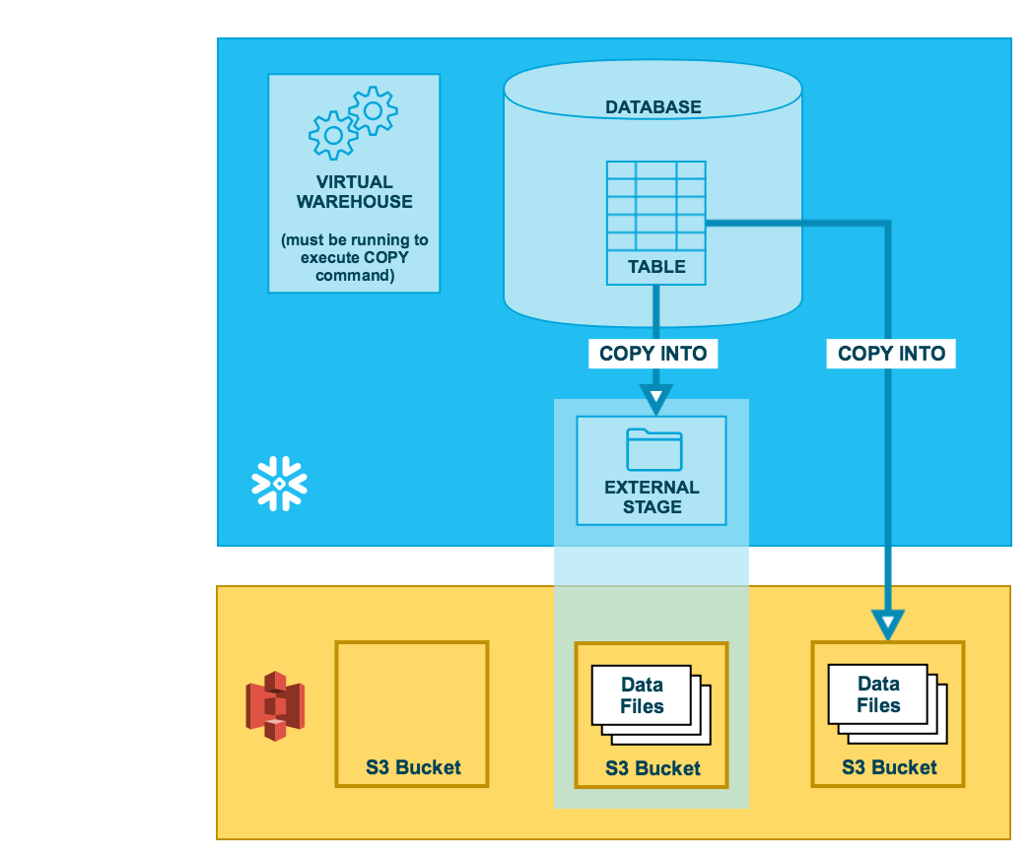
Unloading on to AWS S3

Slide 6
Data Unloading / Export
Unloading Table into External Stage – AWS
copy into s3://sfdbbucket1 from MY_CUSTOMER storage_integration=s3_snowflake_int file_format = (format_name = 'my_csv_format’);
Generating Single / Multiple Files BY Max_file_size
copy into @~ from my_customer single = true;
copy into @~ from my_customer single = false;
Validating Unloading Data
copy into @my_temp_stage from (select * from my_customers limit 5) validation_mode='RETURN_ROWS';

Slide 7
Data Unloading / Export
Unloading Table to Json Format
copy into @~ from (select object_construct('id', id, 'first_name', first_name, 'last_name', last_name, 'city', city, 'state', state) from mytable) file_format = (type = json);
Resultant File -- Sample
{"city":"Salt Lake City","first_name":"Ryan","id":1,"last_name":"Dalton","state":"UT"} {"city":"Birmingham","first_name":"Upton","id":2,"last_name":"Conway","state":"AL"} {"city":"Columbus","first_name":"Kibo","id":3,"last_name":"Horton","state":"GA"}
Unloading Table to Parquet Format
copy into @my_temp_stage/myfile.parquet from (select id, name, start_date from mytable) file_format=(type='parquet') header = true;
Compressed Format – Multiple Files – Performance Advantage
copy into @mystage/myfile.csv.gz from mytable file_format = (type=csv compression='gzip') single=true max_file_size=4900000000;
Getting Files to Local System
get @my_temp_stage file://C:\Snowflake;

Slide 8
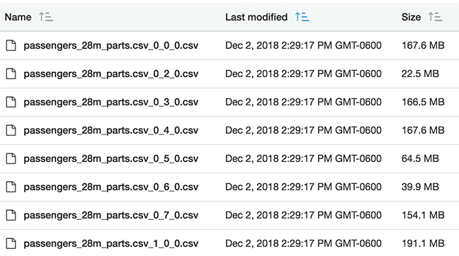
Unloading Big File - Parallel
Multiple File Naming Convention
X_Y_Z
XS 8 => Records are evenly distributed to 8 thread to unload into files.
S 16
M 32
L 64
XL 128
2XL 216
3XL 512
4XL 1024
x = the server number, starting with 0
y = the thread, 0-7
z = the Sequence Number starting with 0
Per Node – 8 Files or 8 Threads
For a Medium 4 Node Cluster – 4*8 = 32 Files / Threads
Best VW Configuration – up until the point where the number of files produced divided by the number of threads was less than two. (32/8) = 4 optimal value is 2
Don’t Use Limit for MAX FILE SIZE – Performance issue

Slide 9
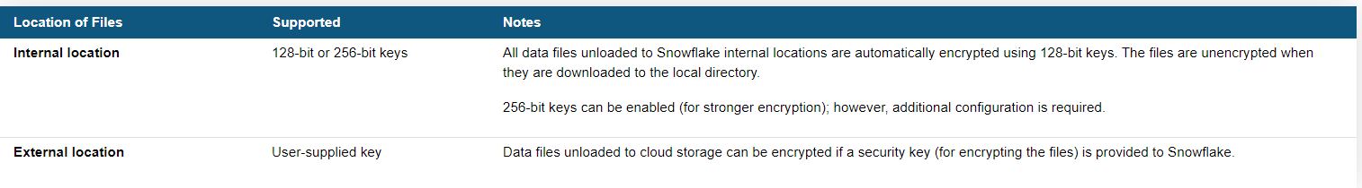
Q & A
How Do I combine multiple files to one file in unloading

Slide 10
Data Unloading / Export
Bulk Unloading
Bulk Unloading
SQL Query Based Unloading
Bulk Unloading to Multiple Files
Unloading onto AWS S3 / GCP / Azure
Default Unloaded File Size – 16 MB
Max File Size – 5gb for AWS / GCP , 268 MB for Azure
Using the Copy Command export the data into any of the stages
Using Get Command the data can be downloaded

